Slide 1
CH 2520 Recitation

Slide 2
Rock Paper Scissors Tournament
Kyle Haustein
Python Analytics Quest: Week 1 Project

Slide 3
Game Overview
Objective:
Beat the computer in a Rock Paper, Scissors tournament.
Win condition:
The player reaches the required number of wins first.
Lose condition:
The computer reaches the required number of wins first.
Extra feature:
The player can replay the game after the tournament ends. The number of rounds can be customized

Slide 4
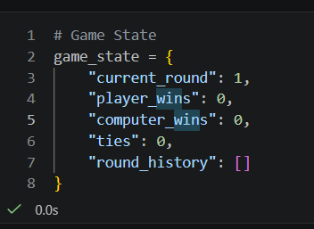
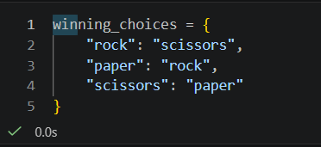
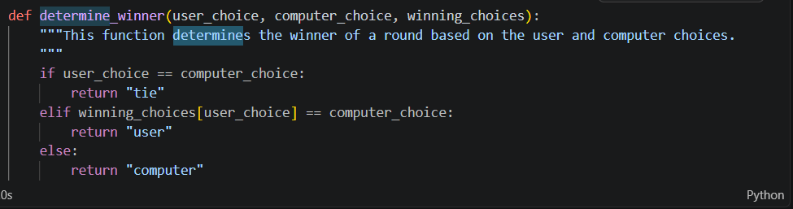
Technical Design
Code Logic
1. Set up the game data
2. Get and validate player input
3. Generate the computer’s choice
4. Decide the round winner
5. Run the tournament loop

Slide 5
Struggles
Biggest challenge:
Logic flow
Problem:
I often ran into errors where a variable or function was “not defined.” This happened when my code tried to use something before it had been created, returned, or called in the correct order.
Solution:
I improved the structure of the game by organizing the code into functions, making sure variables were defined before being used, and wrapping the tournament inside an outer while loop.

Slide 6
Demo
Who wants to play?

